Slide 1

MAT203: Linear Algebra
Review of last week’s lecture
Elimination with matrices
Multiplication and Inverse matrices
Factorization into A=LU
In Ryu
September 22/27, 2016

Slide 2
Review of last week’s lecture

Slide 3
Systems: Modeling and Solving
Modeling: Real Systems ➔ Abstract Models
Into A set of Linear Equations: n equations with n unknowns
Modeling Error
Solving Abstract Models
Solving a system of linear equations : n equations with n unknowns
A unique solution; no solutions; many (infinite) solutions
Elimination method
Errors in Solving

Slide 4
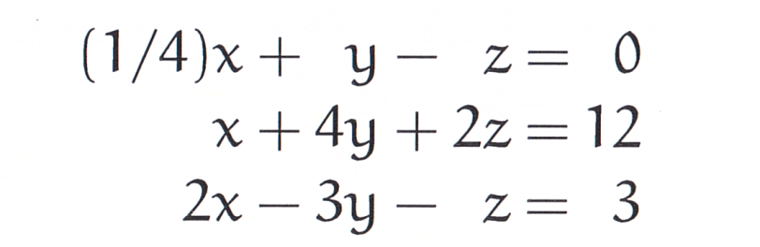
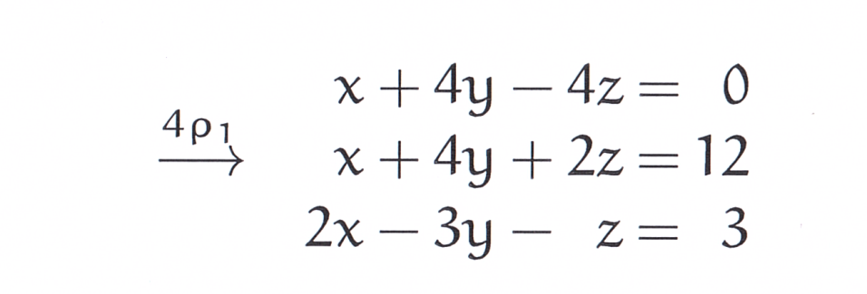
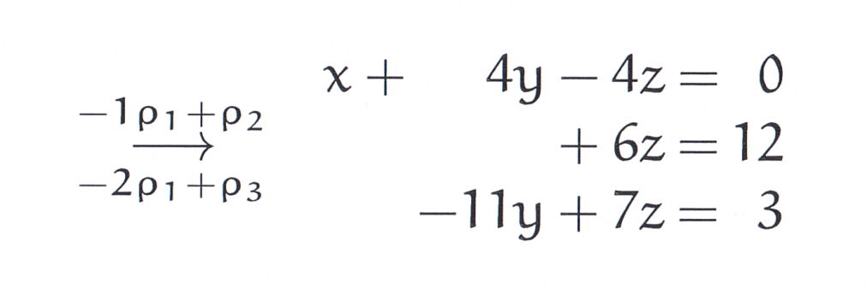
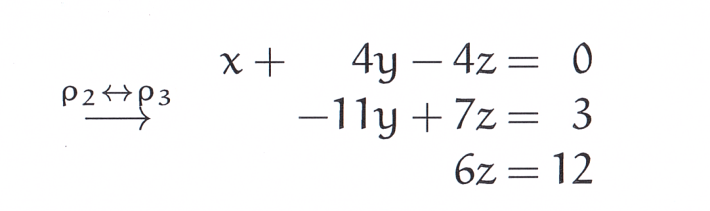
Solving a System of Linear Equations

Slide 5
Matrix form representation of linear equations

Slide 6
Row Picture

Slide 7
Column Picture

Slide 8
Vector Spaces and Subspaces

Slide 9
Vector Spaces and Subspaces

Slide 10
Elimination with matrices

Slide 11
Method of Elimination

Slide 12
Method of Elimination

Slide 13
Method of Elimination

Slide 14
Elimination Matrices

Slide 15
Elimination Matrices

Slide 16
Elimination Matrices

Slide 17
Elimination Matrices

Slide 18
Elimination Matrices

Slide 19
Elimination Matrices

Slide 20
Permutation Matrices

Slide 21
Elimination Matrices

Slide 22
Elimination Matrices

Slide 23
Multiplication and Inverse matrices

Slide 24
Matrix Multiplication 1/4

Slide 25
Matrix Multiplication 2/4

Slide 26
Matrix Multiplication 3/4

Slide 27
Matrix Multiplication 4/4

Slide 28
Matrix Multiplication 4/4

Slide 29
Matrix Multiplication 4/4

Slide 30
Block Matrix Multiplication

Slide 31
Inverses (Square Matrix)

Slide 32
Inverses (Square Matrix)

Slide 33
Inverses (Square Matrix)

Slide 34
Inverses (Square Matrix)

Slide 35
Inverses (Square Matrix)

Slide 36
Inverses (Square Matrix)

Slide 37
Inverses (Square Matrix)

Slide 38
Factorization into A=LU

Slide 39
Factorization into A=LU

Slide 40
Factorization into A=LU

Slide 41
Factorization into A=LU

Slide 42
Factorization into A=LU

Slide 43
Factorization into A=LU

Slide 44
Factorization into A=LU

Slide 45
Factorization into A=LU

Slide 46
How expensive is elimination?

Slide 47
How expensive is elimination?

Slide 48
Homework Assignment #1

Slide 49

Q & A

